Slide 1
Artificial Intelligence Presentation
By: Alvin Ng #100754129
Ame Gilham #10074132
Jackie Zhou #100750922
Ryan Sukhu #100600038

Slide 2
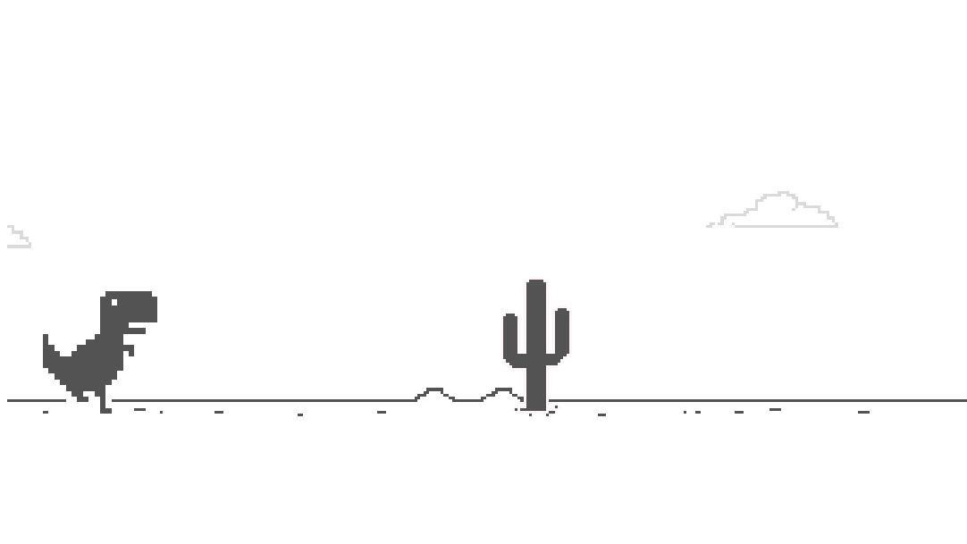
Our Game
Our game is a simple 2D semi-randomized endless runner platformer game like Geometry Dash and the Dinosaur Game, where the main character has to avoid obstacles and if they touch the obstacles they die.

Slide 3
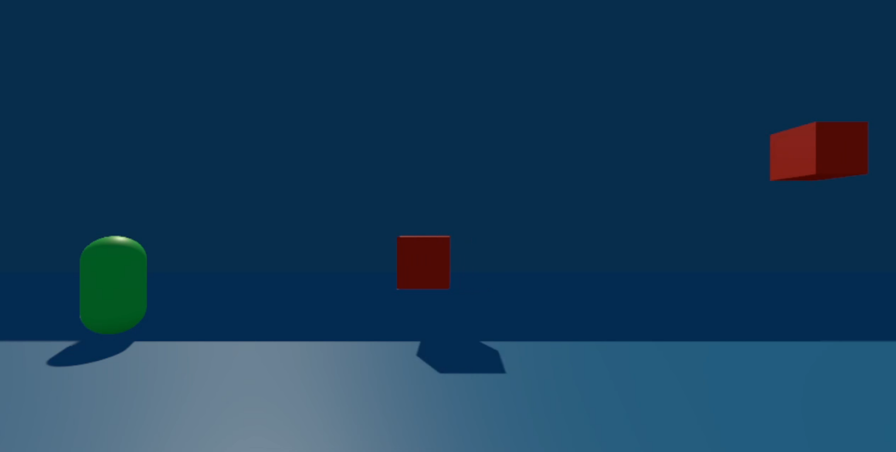

How it works and how it uses AI
Our game has an AI that plays the game and allows the player to watch. The AI character continuously moves towards the right and attempts to dodge obstacles, that spawn from the right, by deciding whether to jump or not. We’ve also implemented a feature that allows the player to choose where the obstacle spawns so they can try to kill the AI.

Slide 4
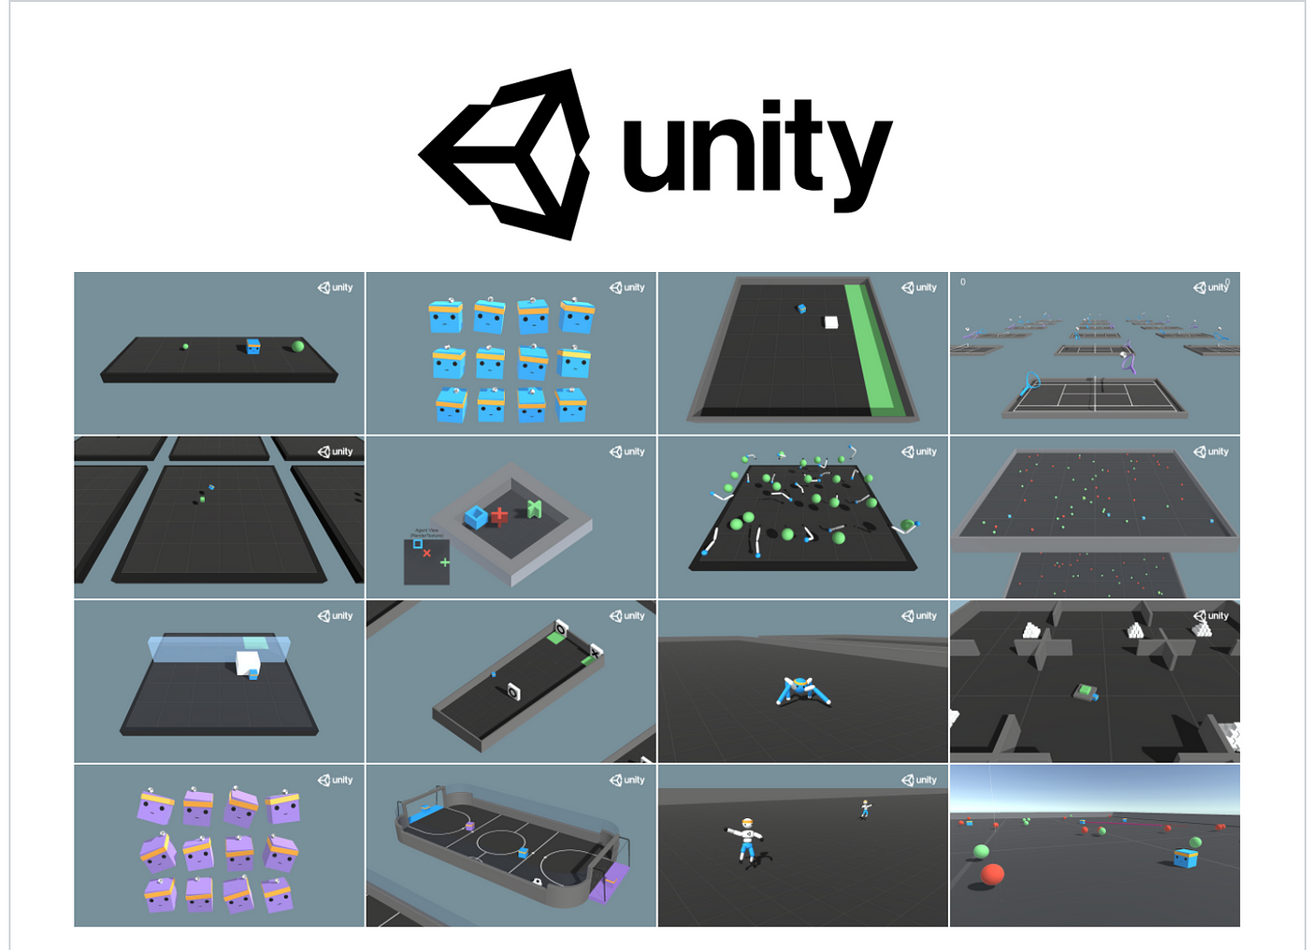
Why we chose it
We opted for reinforcement learning AI as it proved to be a suitable fit for our game concept.
The AI has the ability to learn and determine when to jump in order to evade oncoming obstacles. There are also obvious rewards and punishments that can be given to the AI, such as giving it a reward every time it avoids an obstacle or giving it a penalty every time it enters a state of death.
Reinforcement learning AI is also good at handling unpredictable situations which works well with our randomized obstacle mechanic.

Slide 5
What makes the game interesting?
We think it’s interesting to observe an AI's attempt to survive in an endless run game, as it behaves differently from a human player. Analyzing its actions and motivations adds to the intrigue of the experience since some of its actions can be amusing or funny (such as a scenario where it will sometimes actively jump into a block it could have avoided by staying grounded because it's not sure it will survive and it thinks it's better to die in the air rather than on the ground.)

Slide 6
How we implemented it
We created the AI with reinforcement learning through the Unity machine learning package.
We trained it with 3 million iterations, for the rewards and punishment we implemented a small reward every time it jumps (0.1), a reward for every time an obstacle successfully passes it (10), a base punishment of 30 when it dies (implemented as a negative reward.)
For the first 1 million iterations it also got an extra 30 punishment for dying in the air so it learned to let a lot of the higher obstacles pass it by.
For the rest of the iterations it was inverted so it got an extra 30 punishment for dying on the ground instead, it was really hesitant to jump before that but it learned a relatively good balance of the two and made most of its improvements during these iterations.

Slide 7
Demo Time

